Slide 1
PROJECT NAME :
DATA COMPRESSION
ALGORITHM :
HUFFMAN ALGORITHM
PROJECT LEADER :
JAHANZAIB (19K-1463)
SECTION : C
INSTRUCTOR : MISS FARAH
COURSE : DATA STRUCTURES

Slide 2
ALGORITHM :
It is a method of Lossless Compression. Firstly, we take a word from starting of the file and apply the Huffman Coding.Like File contain its first word “Fast” so it first find out the frequency of every single character from word “Fast”. Like, F = 1, a = 1, s = 1, t = 1.it will assign nodes to every Single Characters and we placed them in ascending order with respect to their given Frequencies.

Slide 3
Than it will take two nodes with least frequencies in that row than -> join them -> and assign it to another node named parent node and it contains the frequency of two joined nodes it repeats until we reach to the last node of Huffman tree and the top node will contain the frequencies of all nodes after joining all the nodes. than assign binary code to every Character. It means that After creating the Huffman Tree than label 0 on left side and 1 on right side of Huffman Tree.

Slide 4
Than we calculate the size of the Huffman codes for every character than add all sizes of each character which will be total size of the encoded message and than we also calculate the size of every decoded character and add them and finally add the size of encoded message and decoded characters size. which will be the total compressed size of the message and file.

Slide 5
PROBLEM STATEMENT:
Genereally, Big Data is one of the biggest problem for software companies and these developed companies creates feasible and fastest approaches to solve these Data Problems. Moreover, Now a days we works on huge amount of data for storing it in micro seconds. So, by storing big data in such pile of seconds we need to minimize the size of data outside the file not inside.

Slide 6
It means that the content will be the same but the data must be compressed from it’s original size. So, for doing this kind of work we need to use built in Algorithms to Compress it or minimize the Size of that Given File. Further more I am learning the Course of Data Structures which is the backbone of managing data in efficient way by using appropriate data structures on the given scenarios.
So, that’ s the problem statement and I’ll tell you the stuffs or data structures that I used in this Project.

Slide 7
DATA SET :
I Have been working on this project for while and I generally use the non-linear data structures in solving real life problems. So, these are the data set for my project.
HUFFMAN TREE
UNORDERED MAP
3) PRIORITY QUEUE
4) PAIR ORDER

Slide 8
APPROACH AND FEASIBLE
SOLUTION:
I looked into too many algorithms for solving this problem statement. then, I find out a general and greedy way/algorithm for solving this problem. After searching a solution , I find an Algorithm called “HUFFMAN ALGORITHM” (LOSSELESS COMPRESSION). This is an algorithm which design a tree and with the help of that tree we encode the data of file and give that data a new encoded version which will be the smaller than the encoded version of original data and the good thing is both versions contains same data when we decode it. So, why not we use this
algorithm to Solve the given data compression problem.

Slide 9
Further more, this is the feasible solution according to my research on this problem statement the reason is that in this algorithm we assign the new encoding to every single character of the given data of that file. So, we manage the encoding like that we first find out the characters are their in file. Then, we will calculate the frequencies of every character on that data file. After calculating the frequencies of every character on that data file then we assign encoded version to distinct character but the main thing is how we assign it? This is the main thing in this approach. So the answer is simple those characters whose frequencies are the most they will be assigned with small no of encoded version and those whose frequencies are not more than one, two and three they will be assigned with large no of encoded version the reason is small no of encoded version will assigned to the most repeating characters.

Slide 10
LIMITATIONS :
In addition, if we talk about the limitations of this Algorithm/Solution.
The limitations are that with the help of Huffman algorithm we can only show the minimized version/compressed version of that data on Console. We can not update the given file into that compressed file the reason is that in 64 bit Architecture processor the smallest size of storing the data in a file is equal to the size of unsigned char , char or we can say that 8bits-> 1 Byte. So, that’s the drawback of this algorithm because as we know that in Huffman algorithm we may assign the encoding less than 8 bits or can be more than it but mostly less than so that is the main approach of compressing the data of file by Huffman which can not be worked on storing in a file.

Slide 11
FUTURE WORK :
As I told you before that many developed software companies are working on big data and on the compression of data with containing same data in a file in same way as it was in original file. In present as well as in future we need only speed on managing data , saving data and storing data. So , these kind of things done by doing the work on that data not on speed. Moreover, we can minimize the sizes of data file with the help of different algorithms and approaches. Also , if we use more efficient algorithm in compressing data we can get a compressed data file in just in a pile of seconds.

Slide 12
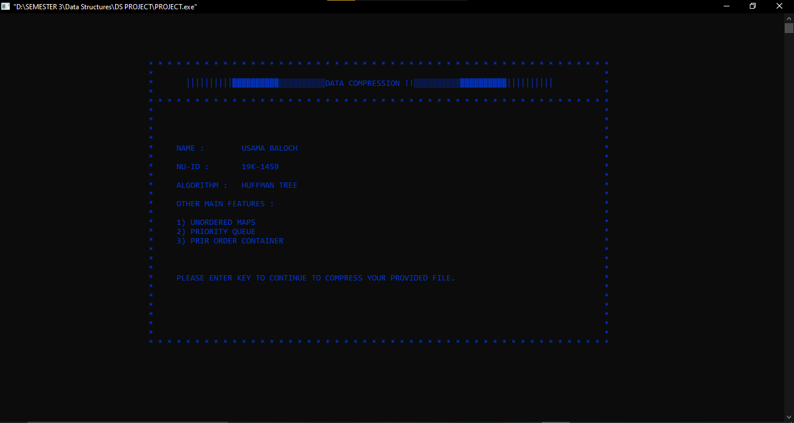
OUTCOMES :
INPUTS:

Slide 13
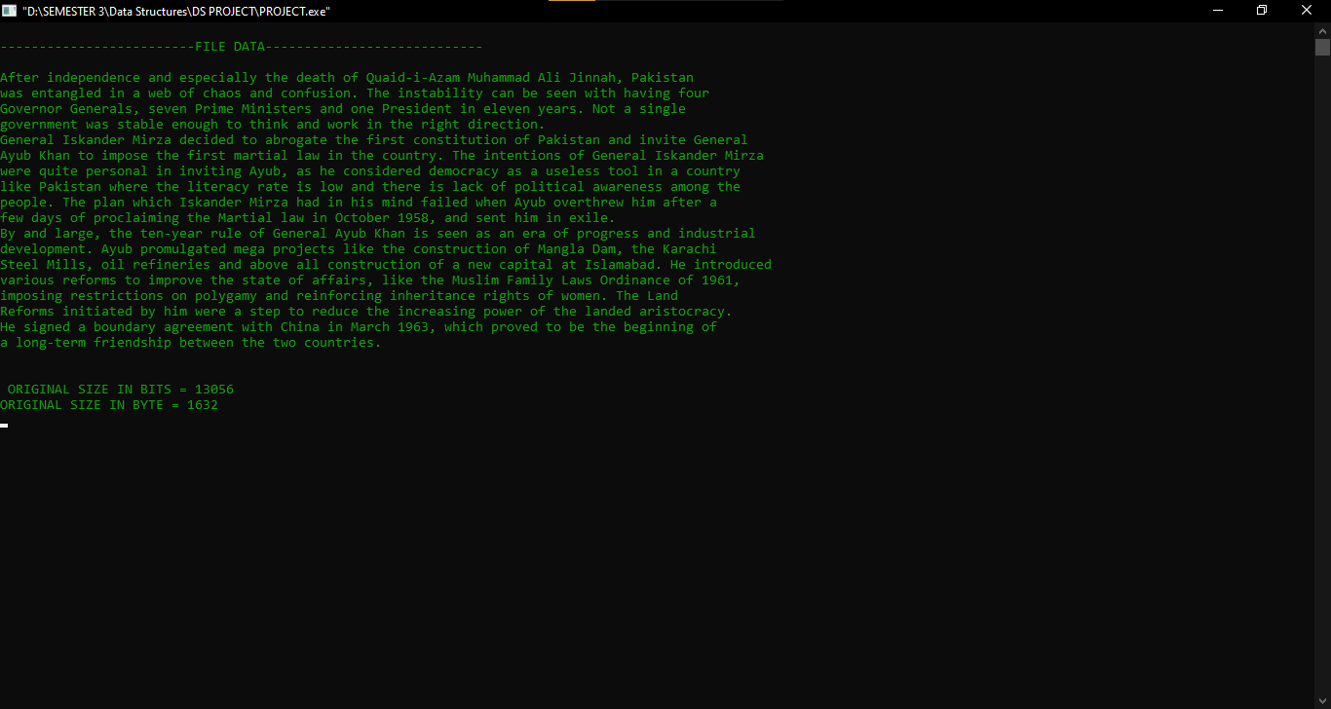

Slide 14
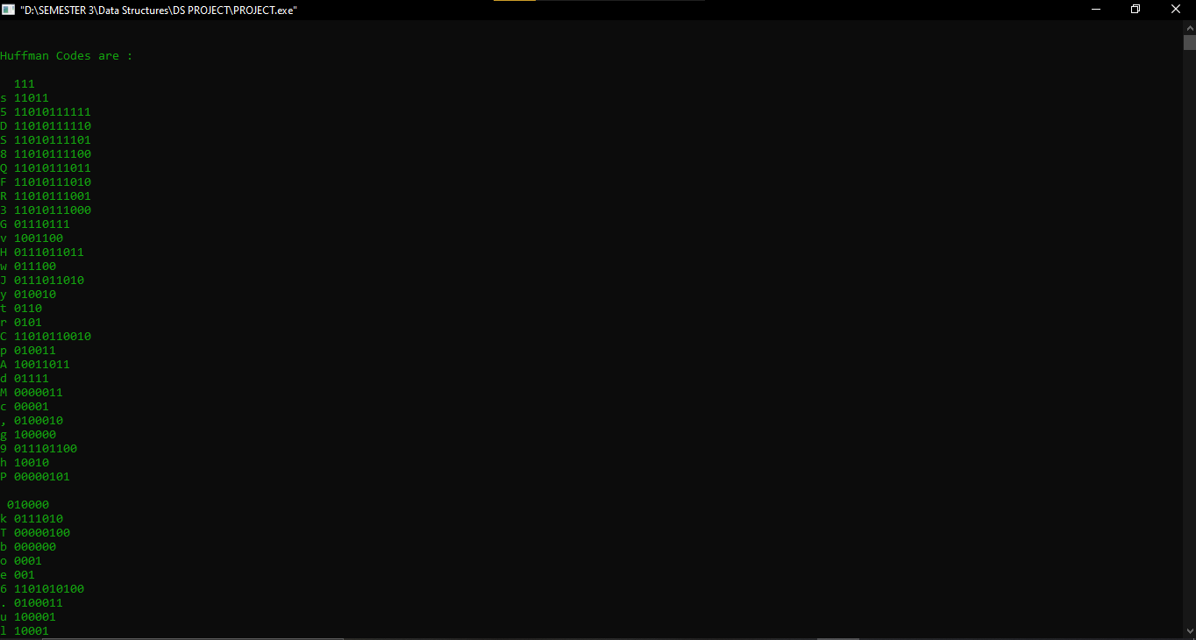
OUTPUTS :

Slide 15
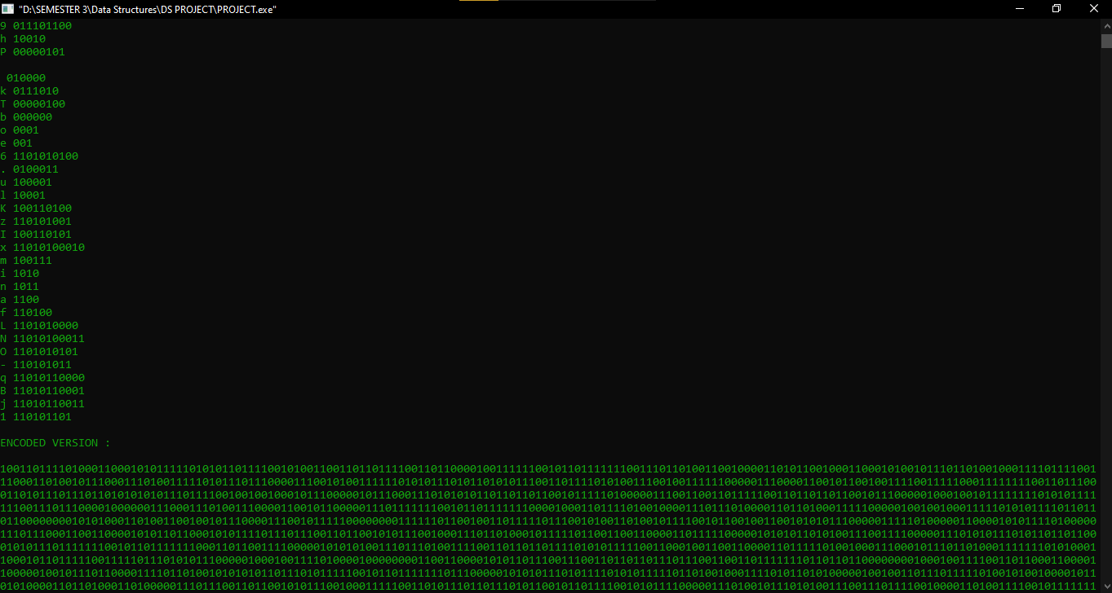

Slide 16
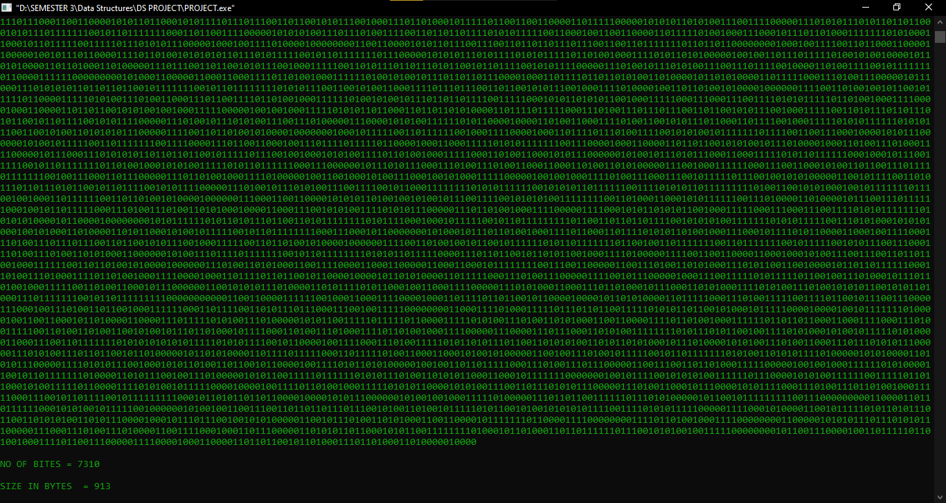

Slide 17
MY WORK:
I have done this project individual by myself. I designed the Huffman Tree which is the main approach in the solution of this problem. I firstly created an unordered_map because to store the calculated frequencies of every character. After this, I created priority queue to store the nodes of Huffman tree means every node is a character so, we store the nodes in that priority queue and the nodes stores according to the bases of their frequencies which means that highest priority node will be those whose frequencies are lowest. Further more, after this we start poping the two nodes with lowest frequencies in that priority queue and merge them as well as their frequencies into another new node named parent node and store it again in that priority queue. At last the priority queue will contain only one node which will be the root node so we take that node and use it to encode the data of file according to Huffman algorithm.

Slide 18
Encode() : it is a recursive function and use to assign the 0 binary number on the left side of that tree and 1 on the right side of that tree. It will work till we reach all the nodes of the Huffman tree.
Decode() : it is a recursive function and use to decode the encoded version of the data file and with the help of root of the Huffman tree which contain the 0’s on the left side of itself and 1’s on the right side. It decode by checking the every string of the file by Huffman tree and check the encoded version of every string to Huffman tree it works like we start from index 0 to till it reach it’s null point (\0), if we got 0 in any index we go to the left of the that node than after this if we get 1 we move to the right side of the past left moved node and it moves till we reach at the one of the leaf of the Huffman tree because our every character is on the leaf node of tree that’s why we move till we reach leaf node and this will work for whole data of the file.

